Slide 1

WELCOME

Slide 2
TEACHER’S IDENTITY
Kartick Chandra Ray
Asst. Teacher
Sarapole Rupdia GPS.
Sadar, Jessore

Slide 3
LESSON IDENTIFICATION
Subject :English
Class : Five
Lesson : Seven
Today’s lesson : Unit B

Slide 4
LEARNING OUTCOMES
1.5.1 Ss will be able to read the text with proper pronunciation
3.1.1 Ss will be able to ask and answer WH questions

Slide 6
PICTURE SHOWING

Slide 7
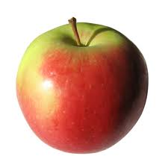
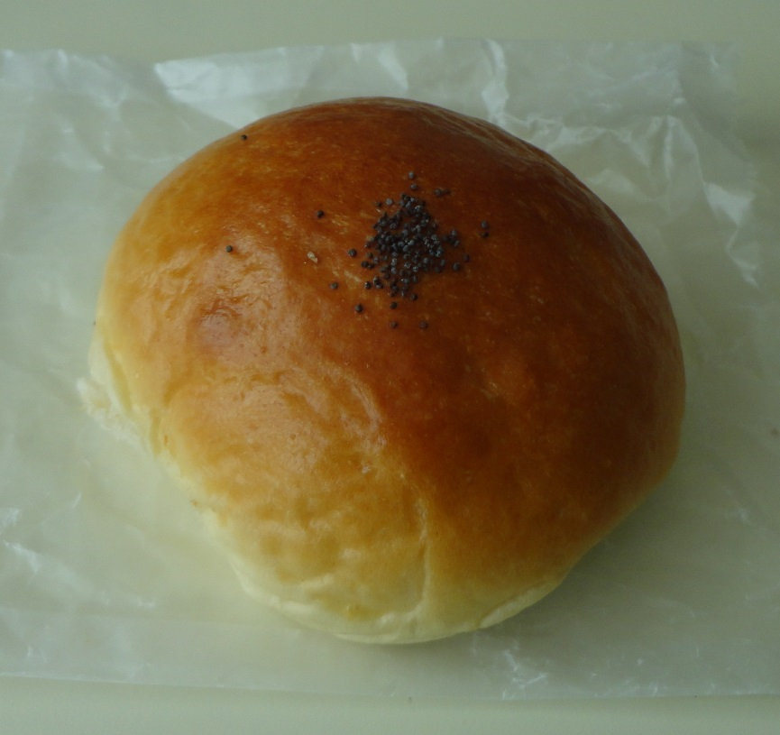
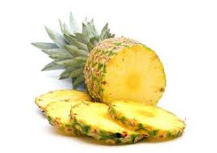
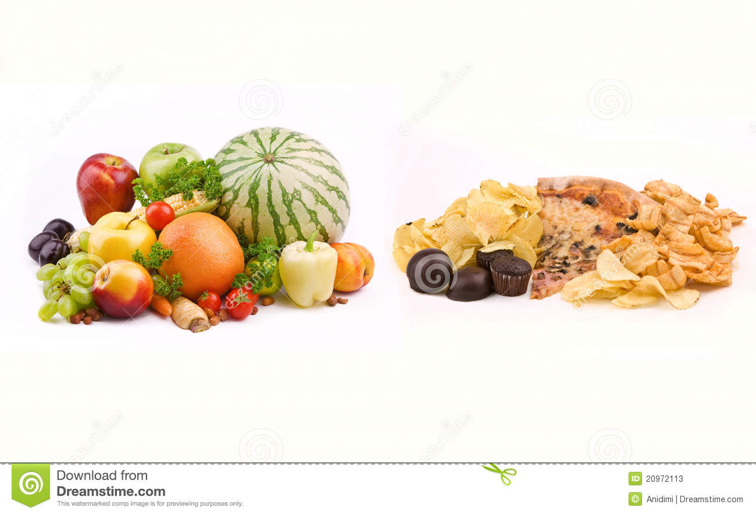
Different kinds foods

Slide 8
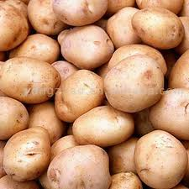
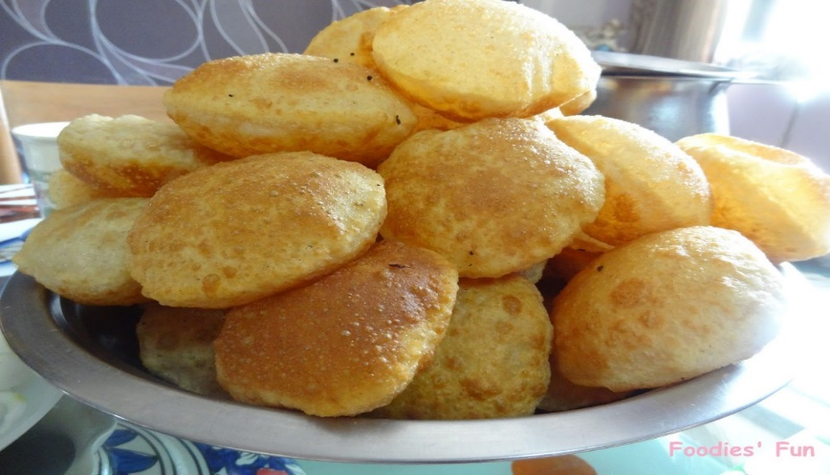
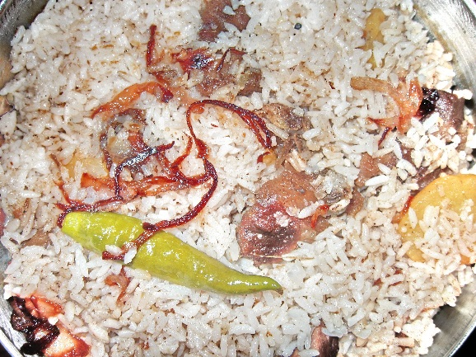
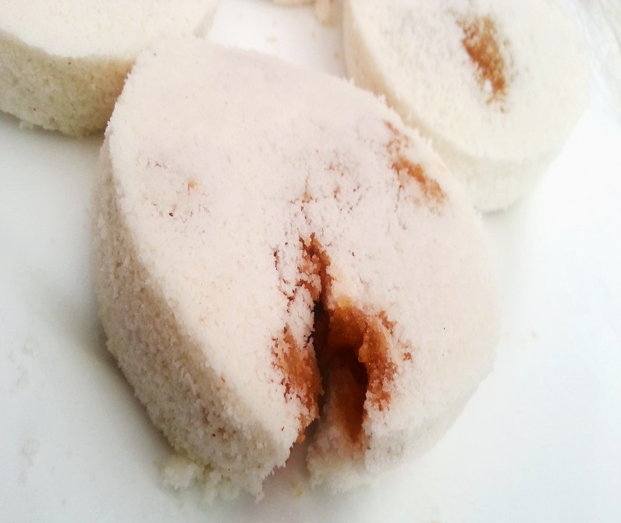
Potato
Luci
Rice
Cake

Slide 9
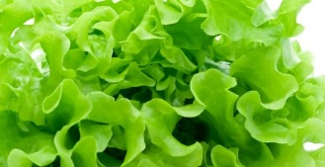
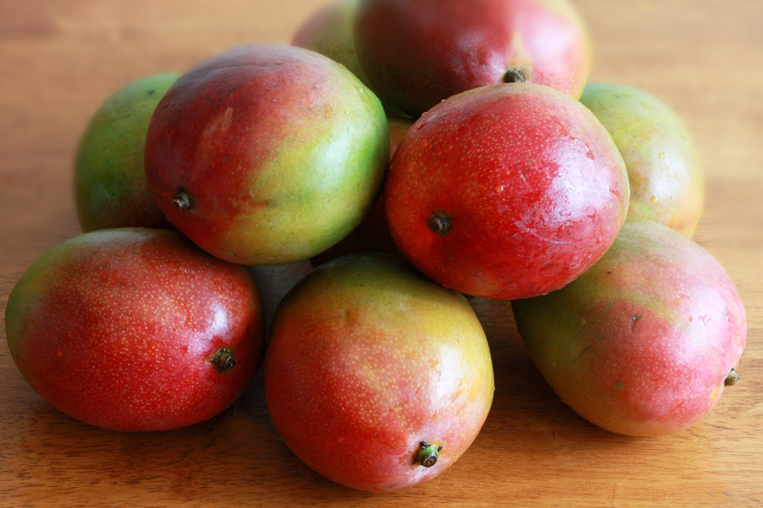
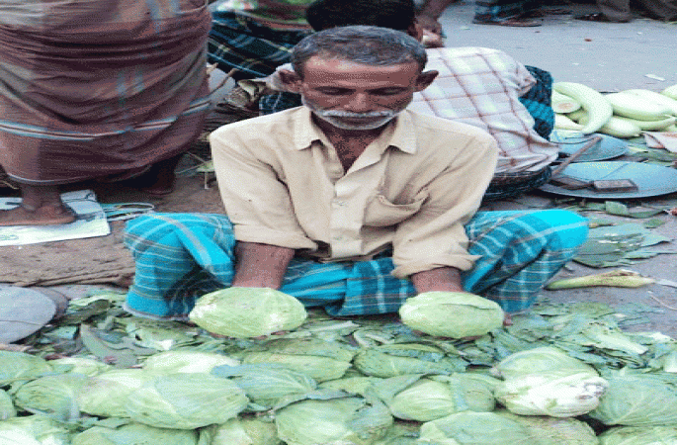
Fruits and vegetables

Slide 10
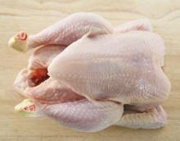
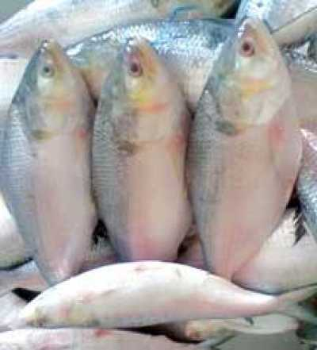
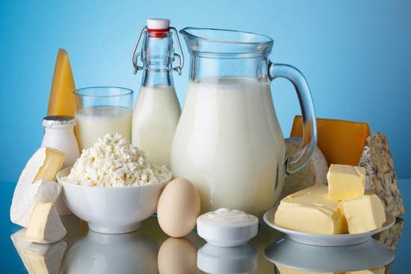
Meat
Fish
Dairy products

Slide 11
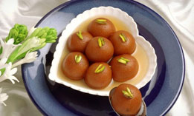
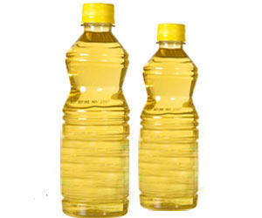
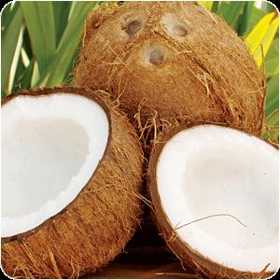
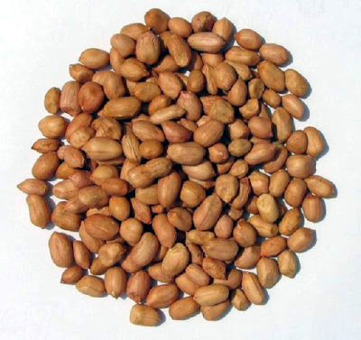
Sweet
Oil
Coconut
Nut

Slide 12
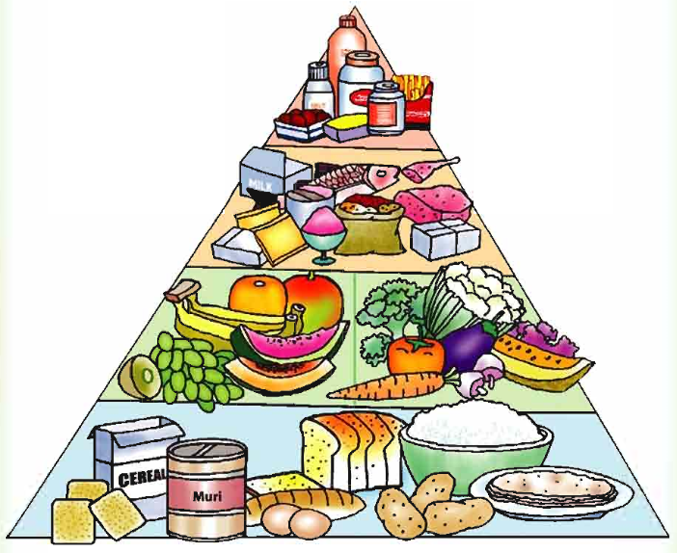
Food Pyramid

Slide 13
Tomato
Rice
Lichi
Cheese
Guava
Carrots
Yogurt
Chips
Vegetables
Fruits
Snacks
Cereals
Dairy

Slide 14
GROUP WARK
GROUP 1 AND 2 : Make a list of fruits and vegetables
GROUP 3 AND 4 : Make a list of foods which are bad for our health

Slide 15
STUDENTS’ PAIR WORK
I WILL MAKE THE STUDENTS 20 PAIRS
ASK AND ANSWER

Slide 16
TEACHER’S READING

Slide 17
Vocabulary
Pyramid
Cereals
Plenty
Moderately

Slide 18
STUDENT’S READING

Slide 19
STUDENTS’ READING IN LOW VOICE

Slide 20
TASK
What is a food pyramid ?
Which food should we eat regularly ?
What is the most important meal of the day ?

Slide 21

THANKS

